Slide 1
AI For Business Leaders Course
Project Slides: Delivering an ML/AI Strategy
© 2024 Udacity.

Slide 2
AI for Business Leaders
Project Step 2C
First Prioritization Grid

Slide 3
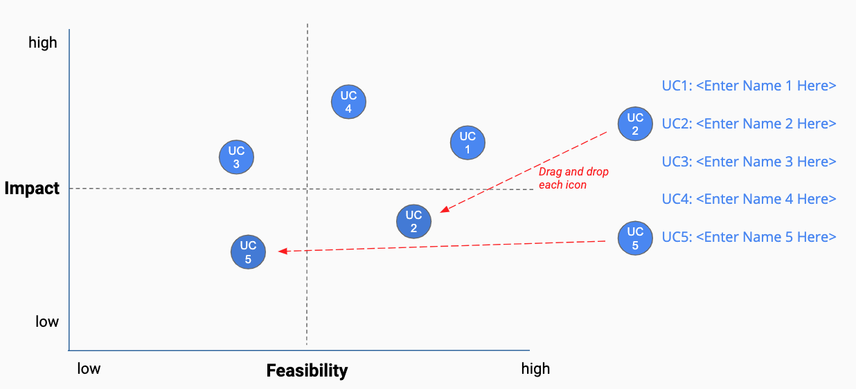
First Prioritization Grid
DIRECTIONS: For each of your use cases, review your answers to the 5V questions in Step 2A, and the operations you chose in Step 2B.
Then on the grid on the next slide, not this slide, move each blue use case icon to a place indicating how you see this use case’s impact and feasibility.
(Recall that the upper right quadrant is usually the most desirable, as it indicates we expect higher feasibility and greater impact.)
UC 2
Drag and drop icons for each use case
Remember to think about both axes!

Slide 4
First Prioritization Grid
(Follow directions on previous slide)
high
UC 1
UC 1
UC1: <Microscopic error-detection system>
UC 2
UC 2
UC2: <Production optimizer>
UC 4
UC3: <Transfer pricing analyzer>
UC 3
Impact
UC 3
UC 4
UC4: <Sales offices allocation tool>
low
low
Feasibility
high

Slide 5
Now Prioritize and Eliminate Three Use Cases
1) Review the locations of your use cases on the grid on the previous slide. Remember we want to prioritize use cases for AI and ML that offer the greatest impact for the least difficulty.
2) Now in the grid on the previous slide change the color from blue to grey for one use case circle you want to de-prioritize.
3) This leaves your top three use cases in blue that you want to move forward with in the rest of the project.
UC 3
UC 3

Slide 6
Excellent, you’ve completed this step of the project!

Slide 7
AI for Business Leaders
Project Step 3
Architectures for Top 3 Use Cases

Slide 8
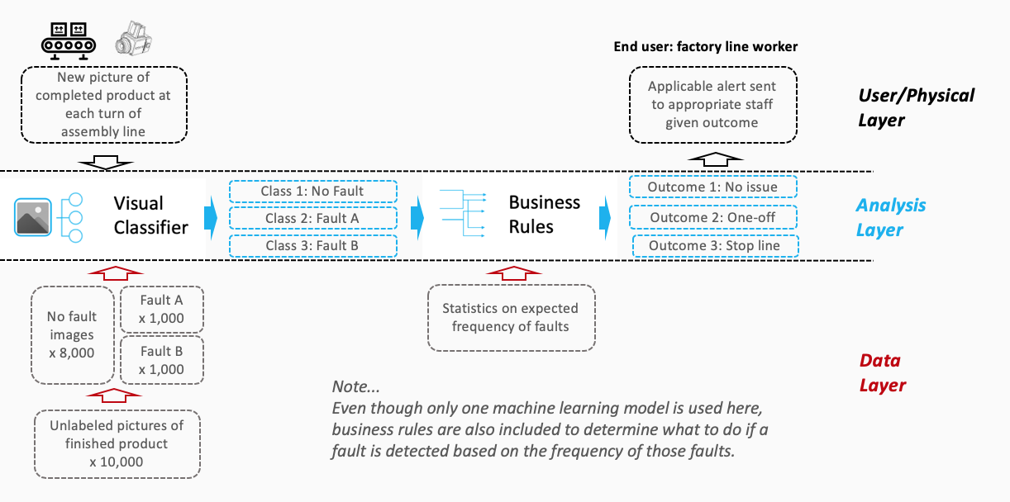

Sample Completed Architecture
Creating High Level Architectures
For the top three use cases you prioritized in Project Step 2C, you’ll now create a high level architecture for each, on slides 10-12.
For this step, be sure to review Lesson 3 but also recognize that this process allows significant creative freedom.
Keep a focus on… - Data flow/direction - Clear view on inputs/outputs - Simplicity
Write the use case name at the top of each slide.
Do all work on slides 10-12:
Copy and paste capabilities from slide 9 into Analysis Layer
Identify relevant User/Physical and Data Layer attributes
Copy and paste arrows from slide 9 to show data flow, input/output
Use annotations to help explain difficult concepts

Slide 9

















AI / ML Toolkit - List of Capabilities
Generic ML Capabilities
Natural Language Processing
Voice/Speech Processing
Computer Vision
Other Capabilities
Drawing Tools
User/Physical Layer
Analysis Layer
Data Layer

Slide 10
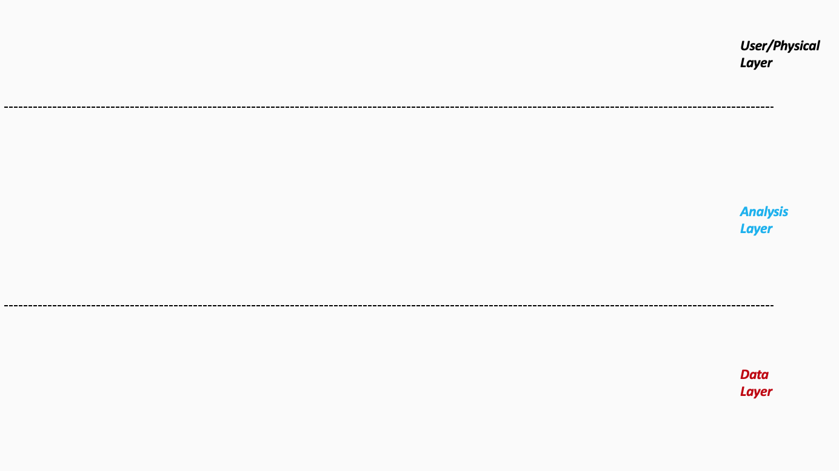
Architecture 1/3 - <Microscopic error-detection system>
Assembly line camera captures new images
Class 1: No Fault
Class 2: Fault A
Class 3: Fault B
Outcome 1: No action
Outcome 2: Alert maintenance
Outcome 3: Stop production
Labeled images of defects and normal products
Unlabeled production images
Sensor logs (optional: temperature, vibration)
Notes:
Please follow the directions on slide 8. Copy and paste the desired icons provided you on slide 9 onto this page.

Slide 11
Architecture 2/3 - <Production optimizer>
Production planning dashboard
Objective: Minimize total cost (inventory + switching)
Constraints:
Lead time, capacity, minimum run size
Simulation of what-if production scenarios
Outcome 1: Suggested weekly production plan
Outcome 2: Switching schedule
Outcome 3: Procurement plan
Historical production volume by model
Line switching costs
Inventory levels
Supply delay history
Demand forecasts
Notes:
Please follow the directions on slide 8. Copy and paste the desired icons provided you on slide 9 onto this page.

Slide 12
Architecture 3/3 - <Sales offices allocation tool>
Corporate strategy / real estate team
Scenario simulation (e.g. open X new stores in region Y)
Outcome 1: Location ranking
Outcome 2: Predicted ROI per location
Outcome 3: Recommended plan
Maximize sales or ROI under budget constraint
Historical sales per location
Demographic data (population, income, density)
Geo-coordinates of existing and candidate sites
Traffic volume and access time
Notes:
Please follow the directions on slide 8. Copy and paste the desired icons provided you on slide 9 onto this page.

Slide 13
Excellent, you’ve completed this step of the project!

Slide 14
AI for Business Leaders
Project Step 4C
Second Prioritization Grid

Slide 15
Second Prioritization Grid
Based on new information from your further analyses of your use cases in step 4A and 4B, you’ll engage in the same exercise as you did before in Step 2C to update your prioritization.
Move onto the grid the three use cases that you have been working with in steps 4A and 4B.
You MAY choose different use cases and shift your focus, if you feel these exercises have caused you to significantly revise your prior evaluations.
UC 2
Drag and drop icons for each use case
Remember to think about both axes!

Slide 16
Second Prioritization Grid
(Follow directions on previous slide)
high
UC 1
UC 1
UC1: <Microscopic error-detection system>
UC 2
UC 2
UC2: <Production optimizer>
UC 4
UC3: <Transfer pricing analyzer>
UC 3
Impact
UC 3
UC 4
UC4: <Sales offices allocation tool>
low
low
Feasibility
high

Slide 17
Now Prioritize and Eliminate One More Use Case
1) Review the locations of your use cases on the grid on the previous slide. Remember we want to prioritize use cases for AI and ML that offer the greatest impact for the least difficulty.
2) Now in the grid on the previous slide change the color from blue to grey for one use case circle you want to de-prioritize.
3) This leaves your top two use cases in blue that you want to move forward with in the rest of the project.
UC 3
UC 3

Slide 18
Excellent, you’ve completed this step of the project!

Slide 19
AI for Business Leaders
Project Step 5
Operational Considerations:
Accuracy, Bias, and Ethics

Slide 20
Accuracy, Bias, and Ethics Concerns
For each of your two remaining use cases, on the next two slides please write 2-3 paragraphs discussing how success will be measured and monitored.
Start by focusing on how model effectiveness would be measured, and speak to what success would look like.
Comment on any other operational concerns, including bias in the data, or ethical limitations, that could influence success.
For each concern you raise, comment on how you would measure or monitor this concern on an ongoing basis.

Slide 21
First Use Case
Please write 2-3 paragraphs here, following the guidelines on slide 19:
To measure success of Microscopic error-detection system, we will look accuracy and also recall, especially for finding faulty product. It is very important that model not miss any product with defect. We will use confusion matrix and calculate F1 score. If the model can catch most defect, and do not stop line too often, we will consider it is success.
However, there are some concern. In our data, most picture are normal product, and defect image is less. This may make model biased and it can ignore rare defect. To fix this, we will balance data and monitor each class performance. Also, we must think about worker. If machine stop line often but it is false, worker may feel stressed. Therefore, we will add human review step and check how often alert is right or wrong. In this way, system can be trusted and safe to use.

Slide 22
Second Use Case
Please write 2-3 paragraphs here, following the guidelines on slide 19:
For production optimization, success is when our plan is better for cost and delivery. First, we check how well our model can predict the demand. If prediction is close to real demand, that is good. Then, we see how much cost is saved by using optimized plan. Less inventory and less switching is good sign of success.
However, if model learn from old data that is not same as now, the plan will not work. We need to update data regular and compare prediction with real sales. Another thing is fairness. Optimizer maybe choose only high margin product, but some area or customer need other models. We need to set some rule to keep balance, and also check region performance to see fairness. In this way, business grow but also all customer get what they want.

Slide 23
Excellent, you’ve completed this step of the project!

Slide 24
AI for Business Leaders
Project Step 6B

Slide 25
Final Prioritization Grid
Based on all of the previous information for each use case, you’ll now engage in the same prioritizing exercise as you have twice before.
You MAY choose to re-prioritize use cases and shift your focus if you feel these exercises have caused you to significantly revise your prior evaluations.
At the end of this exercise, you should have a final point of view on the use cases you’ll advocate in your ML/AI strategy!
UC 2
Drag and drop icons for each use case
Remember to think about both axes!

Slide 26
Final Prioritization Grid
(Follow directions on previous slide)
high
UC 1
UC 1
UC1: <Microscopic error-detection system>
UC 2
UC 2
UC2: <Production optimizer>
UC 4
UC3: <Transfer pricing analyzer>
UC 3
Impact
UC 3
UC 4
UC4: <Sales offices allocation tool>
low
low
Feasibility
high

Slide 27
Excellent, you’ve completed this step of the project!

